Slide 1
BuildFARMs
Where were at.
Oliver Whittington
ithelp@scee.net

Slide 2


Slide 3
1. Before We Begin
What is“Build”
“Build is the process of building source and binary packages, using continuous integration and testing.”
(But it’s also…)
More than pressing F6 in Visual Studio. Build is more than a Jenkins box calling Make. Build is the infrastructure to improve the coder, artist, designer, and QA experience. The experience is improved by reducing the feedback loop of changes. Build is the software and hardware that helps to achieve this.

Slide 4
1. What does it look like?
What does it look like?
[15] VMs / [86] Physical Servers
40 PS4 Devkits.
Virtualized and Physical GPU’s
*Nix and Windows!

Slide 5
WHAT tooling DO WE USE?
Perforce – Version Control
Jenkins – Automation of routine development tasks, continuously polls Perforce for changes and builds our game, tools, and data.
Imogen - Distribute code compilation from workstations and build server to workstations on the floor. Imogen only used for code.
LS Creator - In house level editor. Build uses this to push out changes to all the team
Orbis SDK - ORBIS SDK – compilers, linkers, and package creation tools
AutoTest – Inhouse automated testing software. Runs smoke and daily tests to daily profile our game
LsDataTool – in house distributed data tool. Drives the SMW build farm.
LsBuild / LsAsset – in house asset database, manages all the content that goes into the game.
LsStart - a frontend tools for users to manage their assets, invoke presubmit, and submit testing. Moving users away from using P4V directly

Slide 6
Some notable extra’s.
DART – Coordinate running the game on PS4’s
SN Target Manager – Initiates connections to the devkits.

Slide 7
18 Months BACk
Everything on VM’s (Patching Snowflakes, HA, Much higher utilization of ESX, No GPU’s)
Dependencies on Desktops (No resilience, No out-of-band, rebuilds, patching)
Less understanding of what servers are doing.

Slide 8
The early Relationship
<<< Dinner for 1? >>>

Slide 9
The back of a fag packet.
<<< Matt’s hand drawn diagrams >>>

Slide 10
ENTER The BuildFARM
THE BRIEF:
Texture Shader times 20hrs -> 1hr
DirectX Capabilities
“Cheap as Chips.”
BENCHMARKING FINDINGS?

Slide 11
The Start of something special.
<<< Picture of Me and Matt >>>

Slide 12
The first interation.
IMOGEN DISTRIBUTED BUILD MODEL
Just IMOGEN
Optimizing Multithreading.
Times down…. But more to be done.

Slide 13
The SECOND interation.
RABBITMQ
Message brokering – More control
Balancing multiple workloads to the nodes
Times down further…. More to be done.

Slide 14
The SECOND interation.
RABBITMQ
<<<DIAGRAM>>>

Slide 15
The THIRD ItERATION (In progress)
RABBITMQ -> DUMB COMPUTE.
Getting the nodes to accept any workload.
HURDLES.
Custom Code / Disk / Complexity

Slide 16
A present from Cambridge.
The Dell 720’s (x cores)
More connectivity -> Nimble.
10GB Ethernet.
Pre-Submit

Slide 17
A present from Cambridge.
The Dell 720’s (x cores)
More connectivity -> Nimble.
10GB Ethernet.
Pre-Submit

Slide 18
What failed.
RamDisks for cache (iSCSI VDisks / 3rd party)
Using block for centralized storage.
Using the Isilon for build.
VM’s for build. Management overheads - old disks, use cases changing, machines being over or under spec.

Slide 19
What WORKED
Simple tools: Rsync multithreading
Tarring in transport – Small file.
RabbitMQ for brokering.
Multithreading single threaded processes.
Physical hardware.
Virtualizing GPU’s.

Slide 20
RESULTS
More Resilience and concurrency in the build process.
Texture shaders 20hrs -> 1hr
Build times ? - ?
Package Building ? - ?
Multithreading single threaded processes.
QA Wait times ? -?
Pre-submit and similar advantages?

Slide 21
Some FINDINGS…
Some stuff we noticed along the way.

Slide 22
Why SMALLER CAN be BETTEr…
More instances with less cores VS Less instances and more cores.
<<<Diagram to explain this >>>

Slide 23
The importance of metrics
Their pretty
They help to breakdown the pipeline into smaller services
They give visability of invisible things
They help troubleshoot
They help make informed decisions around purchase
Trends
Why not use Zabbix?

Slide 24
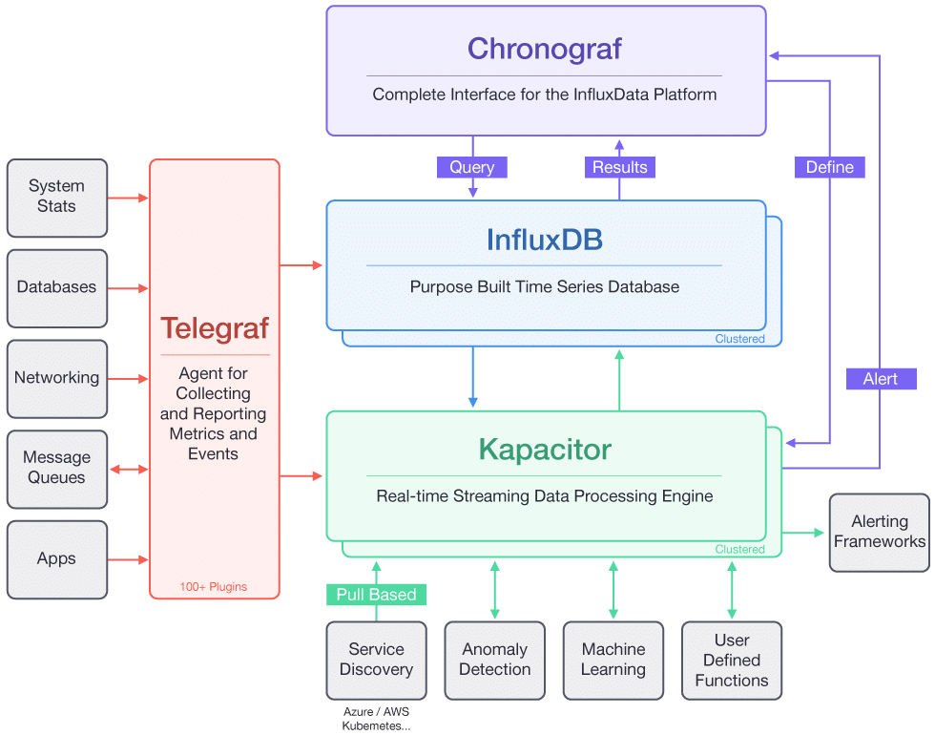

½ t.i.c.k stack with Grafana

Slide 25
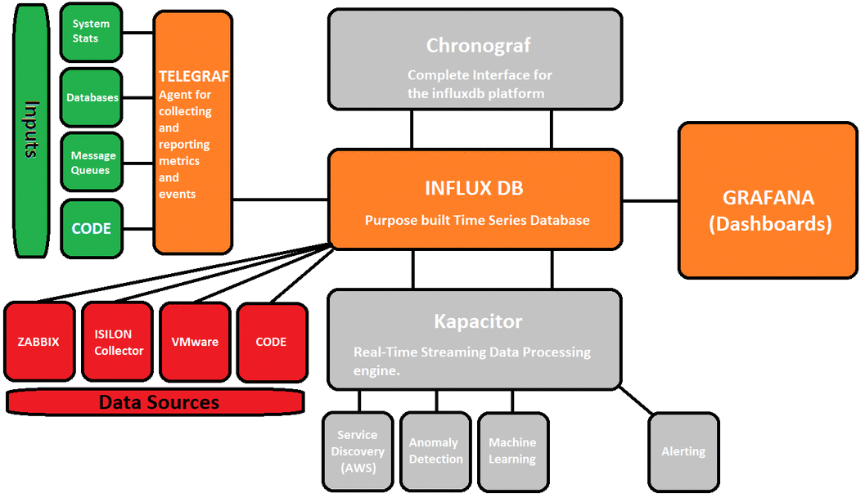
½ t.i.c.k stack with Grafana

Slide 26
Bottlenecks & Troubleshooting
How do we find bottlenecks?
<<diagram>>
How do we troubleshoot them?
<<diagram>>

Slide 27
Visualizing Metrics as Services
Slides of current dashboards.
Render
SMW BuildFarm
Dell BuildFarm
DART
CASPER
Isilon
What are you looking at?

Slide 28
Overlaying Annotations
Why should PDIT care it’s a DEV thing right?
DART
RabbitMQ
SMW Build
Render
Explain.

Slide 29
Ops tools.
CHEF.
Terraform/Vagrant/Ansible/Packer
BASH / IPMI CLI / Powershell (Custom Scripts)
Docker [Guacamole, RabbitMQ, Perforce, Apache
Collectors, Jenkins, Dabbling of forcing concurrency of single threaded processes via containerization.]

Slide 30
POC – DART vGPU FARM
1-16 GPU accelerated VM’s on 1 Server via ESX.
Gets us off NUC’s, Desktops and the service moves back to the comms room.
Gives us more concurrency to run more tests than we ever have
So… Less waiting. A quicker turned achieved.
Paves the way for DART’s future successor to utilize a scalable model.
Feedback from initial testing is great!
Through open dialog and analyzing the build pipeline in smaller bite size chunks through metrics it demonstrates that PDIT can add operational value.

Slide 31
POC – RAM Cache
File Serving through RAM Cache
Our build servers are continuously building the game data so there is a lot of churn and copying data for users.
For our build pipeline, the build server or user builds a piece of data. This data is pushed to shared storage. The data is served via HTTP to a PS4. Every system we use and programming language has support for libcurl. Each build artefact is immutable and identified by a hash. We would use nginx hosted on Linux to serve these files. The files need to be served as quickly as possible and need to be served from RAM and not hit disk.

Slide 32
POC – FLASH ARRAY
Why?
The build pipeline involves a lot of copying the same data. At the start of every build we need to sync from Perforce to get latest. To move work to the SMW nodes they each need to see that data. If we took a build job that have 5 builds and pushes this out to 5 SMW nodes each of those 5 SMW nodes would have to sync from Perforce to their local disks instead of 1 copy we now have to pull 5 down from Perforce, across the network, and to local disk. Build is run continuously so this can be repeated multiple times an hour. We use Perforce to store our build artefacts with are deployed in single changelist back to Perforce. In this example the 5 SMW nodes would have to copy their artefacts from local disk back to the coordinator to be submitted in one go. The SMW do not have enough local disk to store a single branch. Our current workflow has 3 P4 branches (plus an additional one closer to master), and with our feature branch support we would see an increase, The ideal for a job is to sync once to a shared storage then kick off multiple builds that can read and write to the shared storage via SMW. By having shared storage that can also be used as scratch can simply build pipelines, for example of presubmit we would like users to reuse build artefacts between runs, which cannot be done with current setup.
Simplified pipeline
Less duplication of data everywhere. (LUNS, Local disk, scratch folders are dupliated)
Expensive moving of data.
New ways of interacting with the data (NFS over SMB, less chatty and more efficient in tests. Native fast HTTP serving, RESTFUL API for integrating into the pipeline.
Inbuilt metrics specifically for data, (KABANA, Logs, etc)

Slide 33
Proof of concepts.
DART GPU VM Farm
(1-16 nodes.)
est. £80,000
849 CBP/node
149,440 CBP
(Additional 91,840 CBP)
112 x Intel Xeon E3 Nodes
Xeon E3-1265 CPU
32GB RAM
256GB SSD
1Gb/s NIC
12U Installation Size (2 x Fully Populated 6U Chassis)
SILVER
(High End Nodes)
est. £130,000
1800 CBP/node
137,600 CBP
(Addition of 100,800 CBP)
56 x Intel Xeon D Nodes
Xeon D-1581 CPU
64GB RAM
256GB SSD
1Gb/s NIC
6U Installation Size (2 x Fully Populated 3U Chassis)
GOLD
(Best Available Nodes)
est. £250,000
3590 CBP/node
201,040 CBP
56 x Intel Xeon E5 Nodes
Dual Xeon E5-2683 CPUs
64GB RAM
256GB SSD
1Gb/s NIC
12 U Installation Size (2 x Fully Populated 6U Chassis)

Slide 34
Bronze
PRO’S
Cheapest option
Highest CBP/£
Most resilient
CON’S
Slowest frame render times per node
Largest install footprint
Old processor architecture
Current render farm required to match performance of other options
Lower power efficiency
BRONZE
(Low End Nodes)
£80,000
849 CBP/node
149,440 CBP
(Additional 91,840 CBP)
112 x Intel Xeon E3 Nodes
Xeon E3-1265 CPU
32GB RAM
256GB SSD
1Gb/s NIC
12U Installation Size (2 x Fully Populated 6U Chassis)

Slide 35
Silver
PRO’S
Single node renders frames at 2 x the speed of bronze
  Between 1.8x and 3x faster than the current farm
Best all round CPU
Smallest install footprint
New processor architecture
Good CBP/£
Most power efficient
CON’S
Not the fastest technology available
SILVER
(High End Nodes)
£130,000
1800 CBP/node
137,600 CBP
(Addition of 100,800 CBP)
56 x Intel Xeon D Nodes
Xeon D-1581 CPU
64GB RAM
256GB SSD
1Gb/s NIC
6U Installation Size (2 x Fully Populated 3U Chassis)

Slide 36
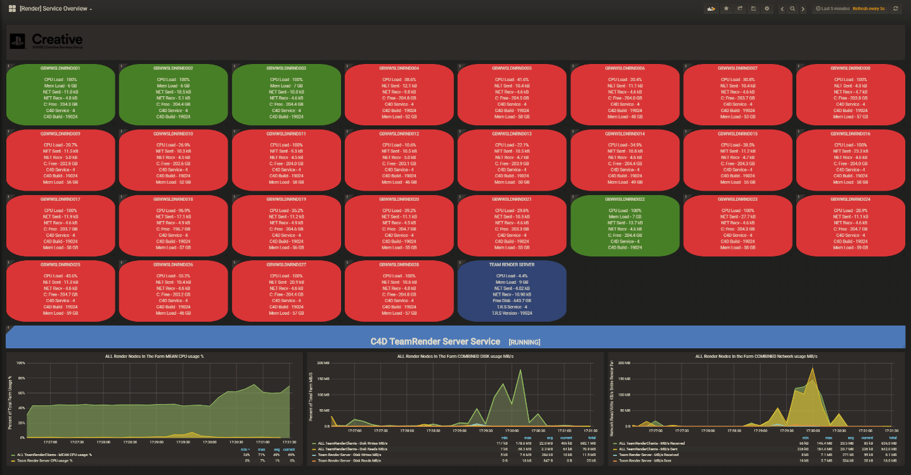
Dashboards
GOLD
(Best Available Nodes)
£250,000
3590 CBP/node
201,040 CBP
56 x Intel Xeon E5 Nodes
Dual Xeon E5-2683 CPUs
64GB RAM
256GB SSD
1Gb/s NIC
12 U Installation Size (2 x Fully Populated 6U Chassis)

Slide 37
Considerations
Future render roadmap
  Potential on-going investment
  Further growth
4k / 8k futures
Licensing / Software Changes
GPU based rendering
Acceptable render speeds for customers
Resiliency requirements
Workflow optimisation

